Slide 1
Determination of the required Power Response of Inverters to provide fast Frequency Support in Power Systems with low Synchronous Inertia
Alejandro Rubio
15.04.2019

Slide 2
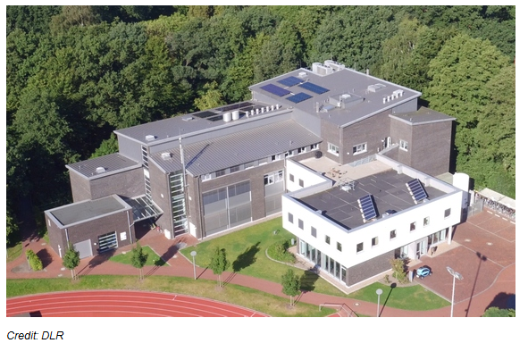
Organizational Structure
DLR- Institute of Interconnected energy systems
The German Aerospace Center (DLR) is composed by several institutes which focuses in different fields for different purposes.
The Institute located in Oldenburg is the Institute of Interconnected energy systems which pursuits the development of new technologies and concepts, based on renewable energies, for supplying the future energy needs.

Slide 3

Organizational Structure
Institute of Interconnected energy systems-Departments
District and Building Technologies (SGT)
Energy Storage (BZS)
Energy Technology Systems (EST)
Analysis of Energy Systems (ESY)

Slide 4








Organizational Structure
Energy Technology Systems (EST)
Every department has multiple working groups. The internship was carried out in the investigation group “Grid Technologies”, led by Dr. Geißendörfer.
The group just started one year ago.
Three researchers and three Master students.
Objective: Develop devices and methods which allow the proper grid operation and integration of renewables energies.

Slide 5




Determination of the required Power Response of Inverters to provide fast Frequency Support in Power Systems with low Synchronous Inertia
Motivation
The “Energiewende”, contemplates to achieve a share in electricity consumption from renewables of 80 percent. As part of it, the renewable energy act, “Erneuerbare Energien Gesetz”, regulates the expansion of renewables and convectional generation decommissioning.

Slide 6






Challenges: More complicated as it sounds!
Technical
Social-Political
Economic

Slide 7
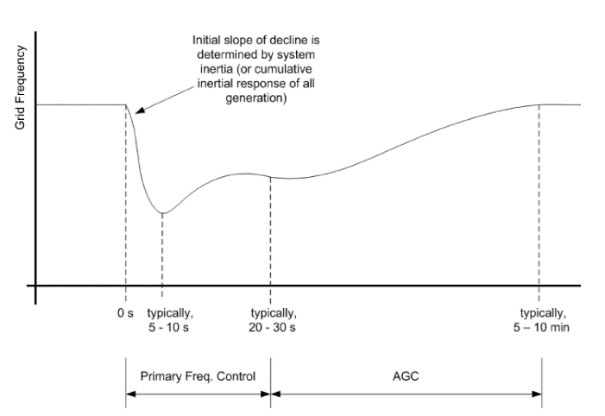
Technical Challenges
Frequency Stability
In conventional power systems, power balancing and frequency regulation is establish through the control of synchronous machines power output.
The balance between generation and load must be maintained so rotor speed and electric frequency are kept constant
Figure 1: Frequency control in power systems (Aho et al. 2012)

Slide 8
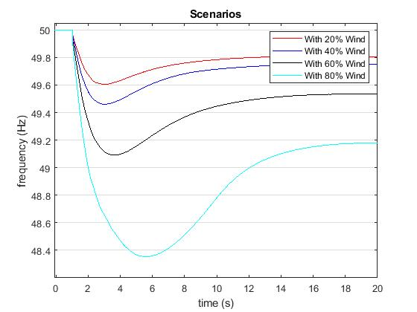




Technical Challenges
Low Inertia grids
PV does not have rotating components
Low inertia from fixed speed wind turbines
Variable speed wind turbines are decoupled from grid dynamics due to the employment of power electronics converters.
Figure 2: Simulated frequency response with 20% load unbalance

Slide 9
What to do?
Some estrategies-Control of RE
Synthetic Inertia
Fast Power reserve
Deloading
Droop-Characteristics
Inverter requirements
What did I do?
Future grid configuration-Control of RE
Dynamic simulations in Power Factory and Simulink
Critical time estimation for frequency collapse
Rate of change of frequency (ROCOF)estimation
Expose of the topic

Slide 10
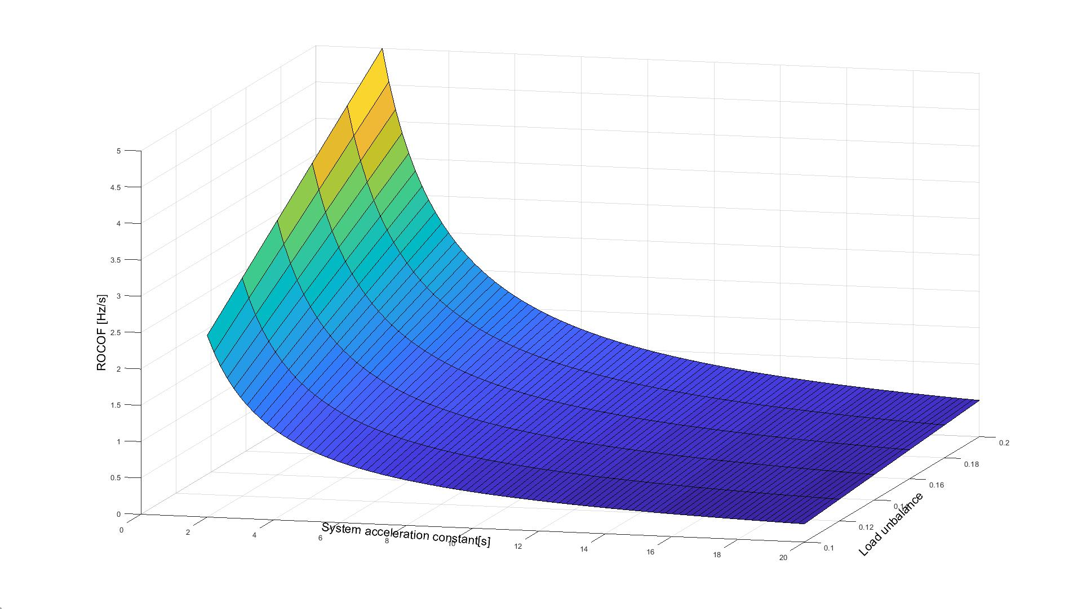

Results
Max ROCOF for different system inertias and unbalances
Figure 3: Rate of change of frequency

Slide 11
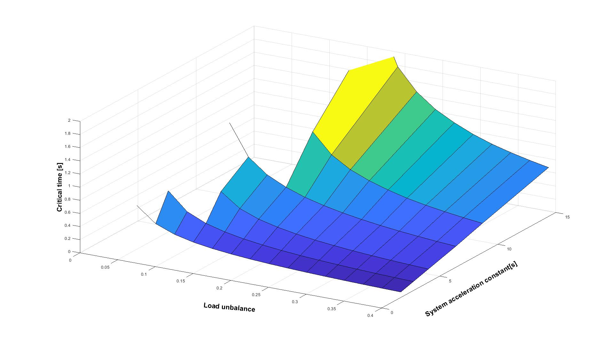
Results
Critical Time (frequency collapse)
Figure 4: Time before load shedding starts

Slide 12
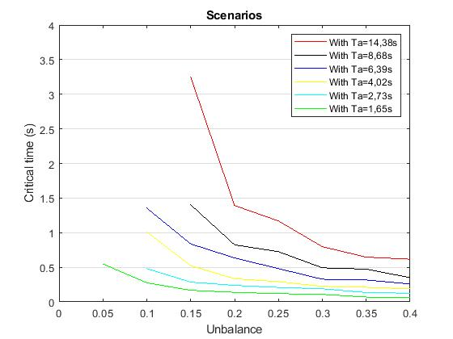
Results
Critical Time (frequency collapse)
Figure 5: Time before load shedding starts

Slide 13
What is next?
Develop inverter control estrategy and determination of power rated needed to supply frequency support (Master thesis).
Validation of results with Real Time Simulator (Hardware in the loop)
It is expected to write a paper about the results of the topic.

Slide 14
Personal Summary
Nice environment for research (very well qualified team, equipment and tools.
Supportive supervision
Germans usually do not like to speak English
A closer look to another „working culture“

Slide 15
References
Aho, J.; Buckspan, A.; Laks, J.; Jeong, Y.; Dunne, F., Pao, L.; Fleming, P. et al. (2012): Tutorial of Wind Turbine Control for Supporting Grid Frequency through Active Power Control: Preprint. Available online at www.nrel.gov.
Anderson, P. M.; Fouad, A. A.: Power System Control and Stability.
Dreidy, Mohammad; Mokhlis, H.; Mekhilef, Saad (2017): Inertia response and frequency control techniques for renewable energy sources: A review. In Renewable and Sustainable Energy Reviews 69, pp. 144–155. DOI: 10.1016/j.rser.2016.11.170.
ENTSOE (2016): Frequency Stability Evaluation Criteria for the Synchronous Zone of Continental Europe. Available online at www.entsoe.eu.
ENTSOE (2018): Rate of Change of Frequency (RoCoF) withstand capability. Available online at www.entsoe.eu.
Gevorgian, Vahan; Zhang, Yingchen : NREL (2017): Wind Generation Participation in Power System Frequency Response. Available online at www.nrel.gov.
Hansen, Anca Daniela; Sørensen, Poul Ejnar; Zeni, Lorenzo; Altin, Müfit (2016): Frequency Control Modelling Basics.
Hoke, Andy (2018): Fast Grid Frequency Support from Distributed Inverter-Based Resources. Available online at www.nrel.gov.
IEEE Guide for Abnormal Frequency Protection for Power Generating Plants.
Jayawardena, A. V.; Meegahapola, L. G.; Perera, S.; Robinson, D. A. (2012): Dynamic Characteristics of a Hybrid Microgrid with Inverter and Non-inverter interfaced Renewable Energy Sources: A case study.
Kroposki, Benjamin; Johnson, Brian; Zhang, Yingchen; Gevorgian, Vahan; Denholm, Paul; Hodge, Bri-Mathias; Hannegan, Bryan (2017): Achieving a 100% Renewable Grid: Operating Electric Power Systems with Extremely High Levels of Variable Renewable Energy. In IEEE Power and Energy Mag. 15 (2), pp. 61–73. DOI: 10.1109/MPE.2016.2637122.
Kundur, Prabha: Power System Stability and Control.

